Slide 1
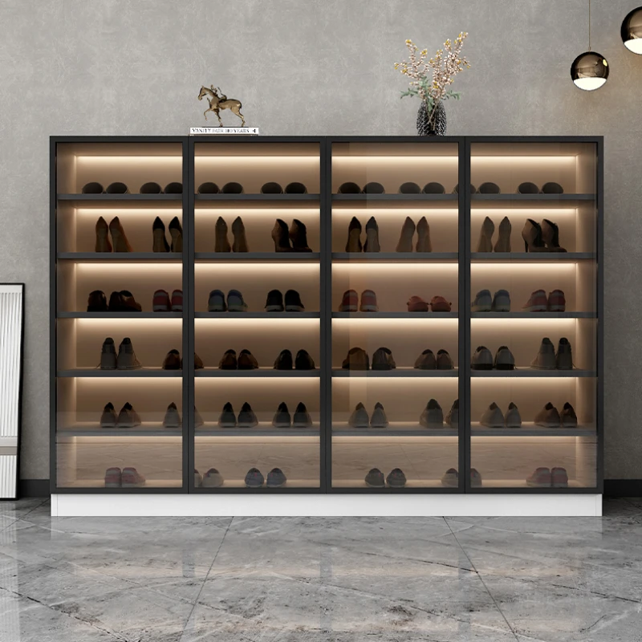
AUTOMATIC SHOE CABINET
CHONG KHENG CHEN
03DET22F1043

Slide 2
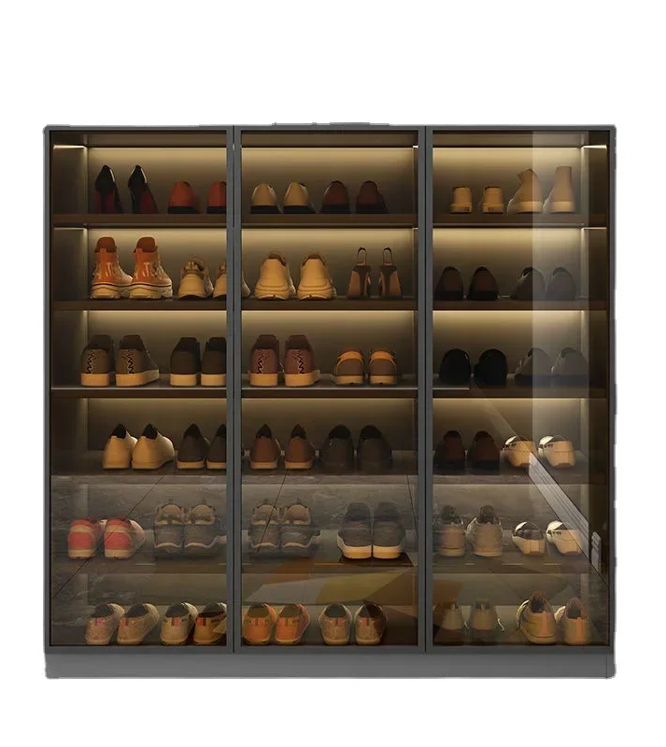
KETERANGAN PROJEK
PENYATAAN MASALAH :
Because there are some tall cabinets that are difficult to put it in .
Don’t know where there are any free seats.
Because it is dangerous to climb high stairs to put things away .

Slide 3
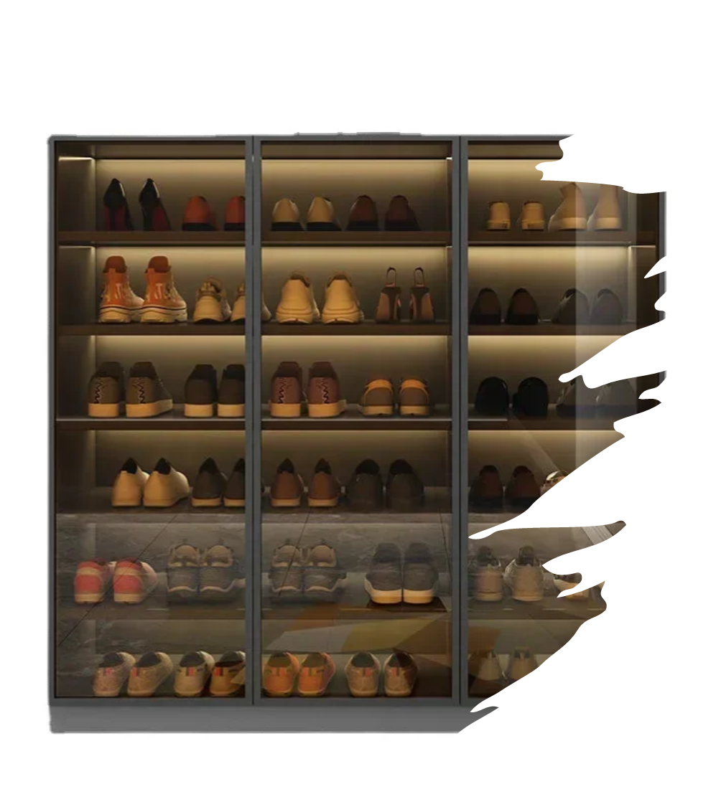
OBJEKTIF PROJECT:
Reduce the time spent putting shoes in the shoe cabinet .
Reduce the risk of people climbing stairs.
Convenient for people to put their shoe .

Slide 4

SKOP KAJIAN :
SHOE STORE
SHOE FACTORY
Some people have a lot shoe at home .

Slide 5
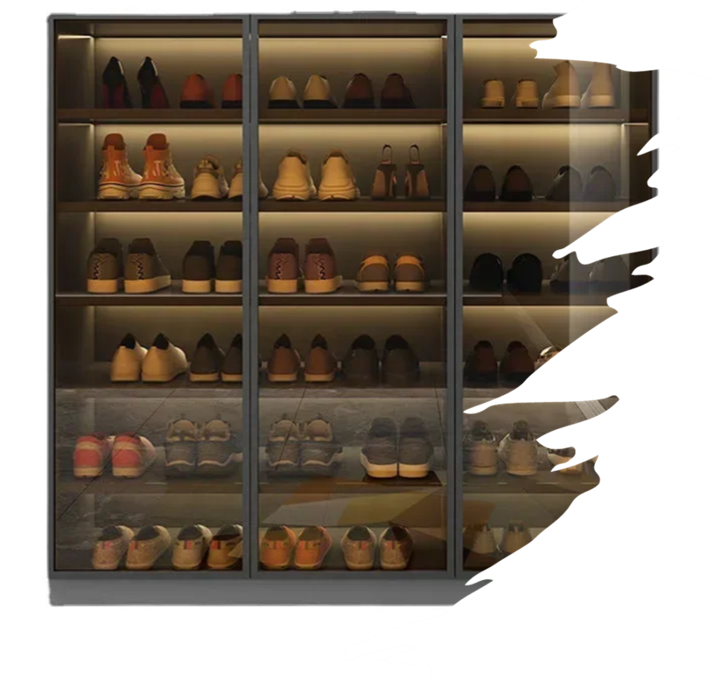
KOS:
1.INFLARED SENSER - RM 3 X 10 = RM30
2.STEPPER MOROR – RM40 X 2 = RM 80
3.MOTOR – RM10 X 10 = RM100
4. PAPAN – RM 50
5.ELETRICAL PANEL- RM50
TOTAL =RM310

Slide 6
THANK YOU !!!

